Slide 1
Cryo-electron microscopy
By
Aparna Patil Kose
Lecturer
Dept of Bioinformatics
G N Khalsa College

Slide 2
Introduction
Cryo-electron microscopy (Cryo-EM) is a type of transmission electron microscopy (TEM) that allows for the specimen of interest to be viewed at cryogenic temperatures (-150 degree)
Following years of improvement, the cryo-electron microscope has become a valuable tool for viewing and studying the structures of various biological molecules.

Slide 3
TEM
Transmission Electron Microscopy (TEM) refers to a technique where the image (of specimen) is formed by directing a high energy electron beam at a thin sample.
While cryo-electron microscopy encompasses a number of experimental methods (imaging intact tissue sections, imaging plunge frozen cells and virus etc), these methods are based on the principle of imaging radiation-sensitive specimens in a transmission electron microscope.

Slide 4
Understanding the Significance of Electrons (Electrons vs. Photons)
Photons are packets of energy (basic particles of light) therefore, everything that one sees with their own eyes is due to the fact that these particles reflect off the physical objects we perceive and into our eyes.
However, because some of the objects (of specimen in this case) are too small compared to the wavelength of photons, they are unable to interact making it impossible to view them.
When it comes to the wavelength of electrons, it is small enough to interact with the objects making it possible to observe them.
Therefore, electrons become more suitable for the purposes of observing the small components of cells as well as a variety of molecular structures.

Slide 5
Transmission Electron Microscope
There are two major types of electron microscopes;
The scanning electron microscope
The transmission electron microscope.
However, because of the fact that the transmission electron microscopes offer higher resolution compared to the scanning electron microscopes, they are preferred when it comes to structural biology.

Slide 6
How the Cryo-EM Works
TEM use the same working principle as the ordinary light microscope.
However, rather than using the limited wavelength of light, electrons with much lower wavelengths are used as the source of light.
For the TEM, there are two types of electron sources that are commonly used.
thermionic electron guns and
field emission guns.
Whereas electrons are emitted from such heated filaments as bent tungsten or sharp lanthanum hexaboride crystal in thermionic electron guns, they are emitted from a sharp, pointed cathode by a string electric field in field emission guns.
For TEM, the electron gun uses electronic coils as well as high voltages to accelerate the electrons to extremely high speeds (thus shorter waves). The electrons then travel through the anode, an aperture and into the vacuum tube.
Unlike the light microscope, the TEM has in place electromagnetic lenses that bend the electron beam though the Lorentz force. The lenses also direct the beam through the tube and onto the specimen.

Slide 7
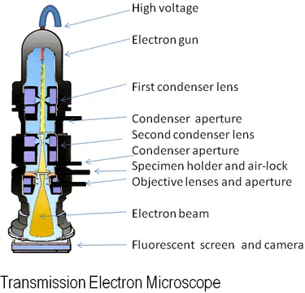

Slide 8
WORKING
In Cryo-Electron Microscopy the sample under observation is usually frozen (frozen-hydrated) for preservation purposes.
Here, a very thin slide of the specimen may be rapidly plunged into a liquid ethane bath and viewed in their natural state.
Solvents like water or a salt solution is used to ensure that the sample remains stable.
i.e The solvent water around the specimen is frozen in place when the sample is plunged into the cold medium thus cryogenically preserving and protecting the specimen.

Slide 9
it is very important that the process of freezing the sample is very quick and prevents the frozen water around the specimen sample from forming cubic ice.
In the event that ice is formed, it readily absorbs the electron beam, which in turn conceals the sample.
For this reason, it is essential that the sample be plunged in to the cooling liquid rapidly so that the water only freezes around the specimen for clear images.

Slide 10
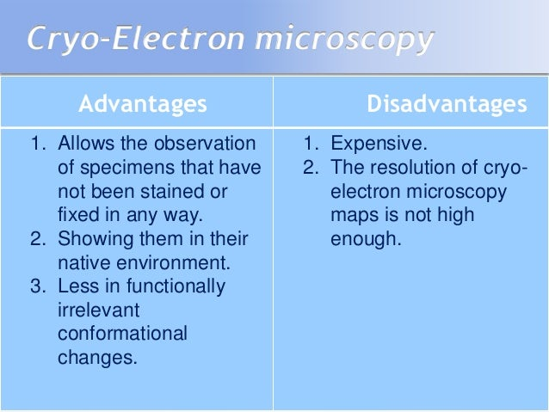

Slide 11
Cryo-electron microscopy
Limitations and Applications
(Self Study)

